Slide 1
Nouns and Countability

Slide 2
Outline
Introduction
Conceptual Semantics
Chierchia’s approach
Natural Semantic Metalanguage
Conclusion

Slide 3
Introduction
Count nouns vs Mass nouns
Count nouns
An egg, one egg, many eggs
Mass nouns
tea, much tea, three boxes of tea
Substance reading
There is too much egg in the eggnog
Kind reading
A tea, many teas
There are also other types of countability
Furniture, scissors, news

Slide 4
Conceptual Semantics
Developed by Jackendoff
Countability is accounted for by two features boundedness [±b] and internal structure [±i]
An entity is [+b] if and only if:
It is indivisible
It is not additive
Singular count nouns are bounded [+b]; mass nouns are unbounded [-b]
A teapot is bounded
Mud is unbounded

Slide 5
Conceptual Semantics
An entity is [+i] if and only if:
It is made up of separate individuals
Aggregates (plurals) are [+i] ; mass nouns are [-i]
Teapots are [+i]
Mud is [-i]
Group (collective noun) is [+b, +i]
E.g. a team, a band
May show plural agreement pattern

Slide 6
Conceptual Semantics
Nouns
+b
-b
+i
-i
+i
-i
[+b, +i]
GROUP
a team
a band
[+b, -i]
INDIVIDUALS
a teapot
a person
[-b, +i]
AGGREGATES
teapots
cattle
[-b, -i]
SUBSTANCES
mud
rice

Slide 7
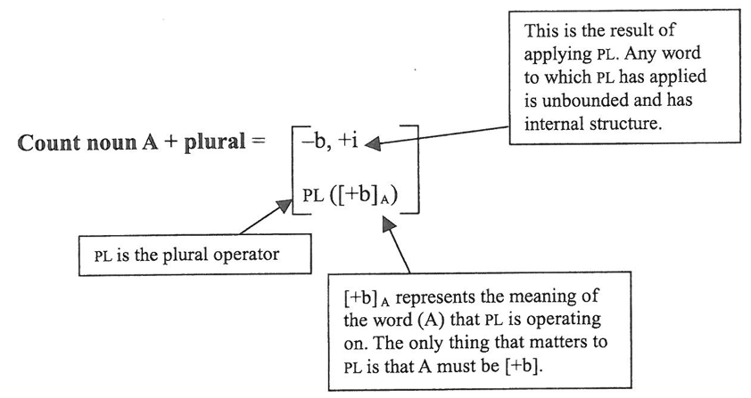
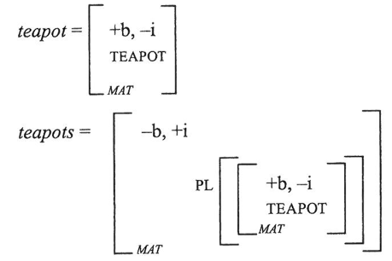
Modeling variation in CS
The PL function applies to a bounded noun ([+b], teapot or team) and creates a plural noun ([+b, +i], teapots or teams)

Slide 8
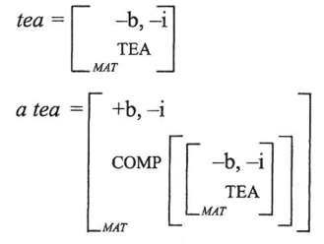
Modeling variation in CS
The Universal Packager function applies to substance ([-b, -i], tea) and turns it to an bounded individual ([+b, -i], a tea)

Slide 9
Evaluating CS
Furniture, clothing, footwear, change and luggage are like mass nouns morphosyntactically
However, their internal structure is different from mass nouns; they have clearer individuals within them (a sofa + a chair = furniture)

Slide 10
Chierchia’s approach
Chierchia argues that mass nouns (incl. substance and furniture-type nouns) are:
Inherently plural
This explains why they generally cannot be pluralized
Neutralized in terms of singular-plural distinction
This explains why they generally cannot be counted

Slide 11
Evaluating Chierchia
Chierchia does not explain why substance and furniture-type nouns do not behave alike with regards to the Universal Packager
A rice ‘an order or rice’
*A furniture (c.f. a piece of furniture)
Other approaches assume the Universal Packager does not apply to furniture-type nouns because they have different semantic properties

Slide 12
Natural Semantic Metalanguage
NSM is based on Bogusławski’s works, and further developed by Wierzbicka and Goddard
For Wierzbicka countability is semantically motivated
Difference in countability reflects difference in conceptualization

Slide 13
NSM
Wheat is uncountable because wheat grains are not big enough to be perceived as countable
Oats are bigger and are countable
However, oats do not behave entirely like teapots
?many/four hundred oats
some/a lot of oats

Slide 14
NSM
Spaghetti in English and in Italian
Not countable in English
Countable in Italian (1spaghetto, 2 spaghetti)
For Wierzbicka there are at least 14 countability types, each with different semantics and morphosyntactic behaviors

Slide 15
NSM
Goddard spells out more finely countability types
Singular names for homogenous substances (cheese, glass, paper)
Something of one kind
People can say what kind with the word cheese
People can’t think about something of this kind like this:
‘this thing has many parts, someone can know how many’
Aggregates of small, unnamed things (oats, coffee grounds):
Something of one kind
People can say what kind with the word oats
People can think about something of this kind like this:
‘this something is many small things.
There can be many of these small things in one small place.
People can do something to one of these things with one finger’
Countables (cat, teapot, chair, dog)
Something of one kind
People can think about something of this kind in one of these ways:
‘this something is one thing of this kind
this something is not one thing of this kind, it is more things of this kind’

Slide 16
Evaluating NSM
Important generalization may be missed
NSM lists different entries for
Countable food item as substance
There’s a lot of egg in this soup (cf there are 3 eggs)
Countable material as substance
I used cedar to make the chair (cf I planted a cedar)
Bidirectionality issue
Is it cultural relativity or linguistic relativity? How do they interact with each other?
Weight scale in the USA vs weight scales in Australia

Slide 17
Conclusion
Thinking of a referent in a different way can change its countability (tea vs a tea)
If different cultures interact with the referent in different ways, the languages’ nouns for the referent may have different countability types

